Slide 1
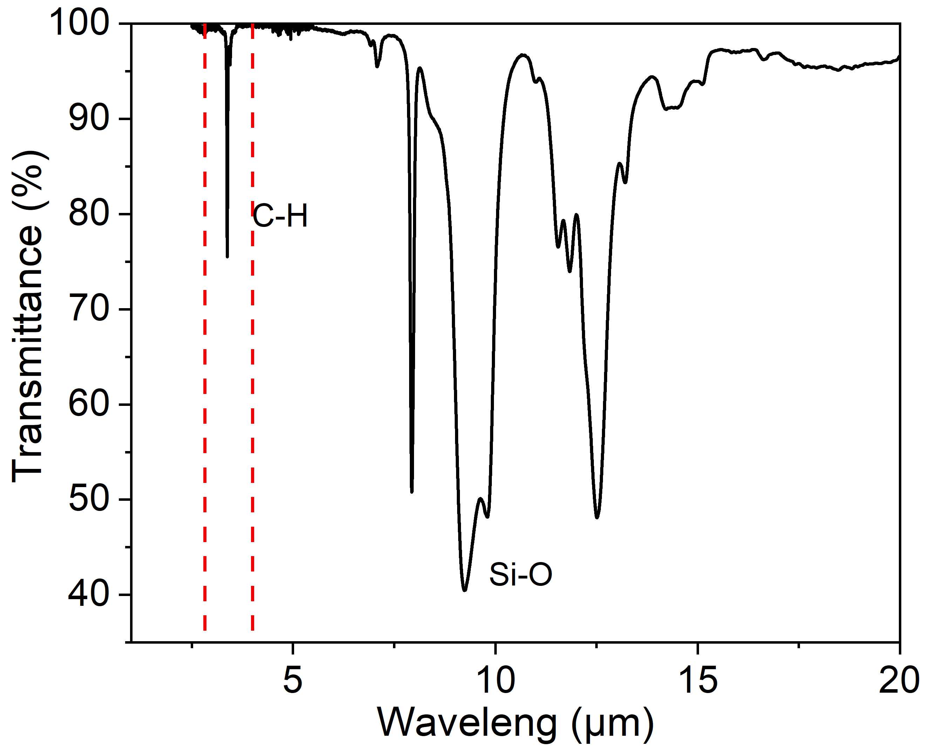
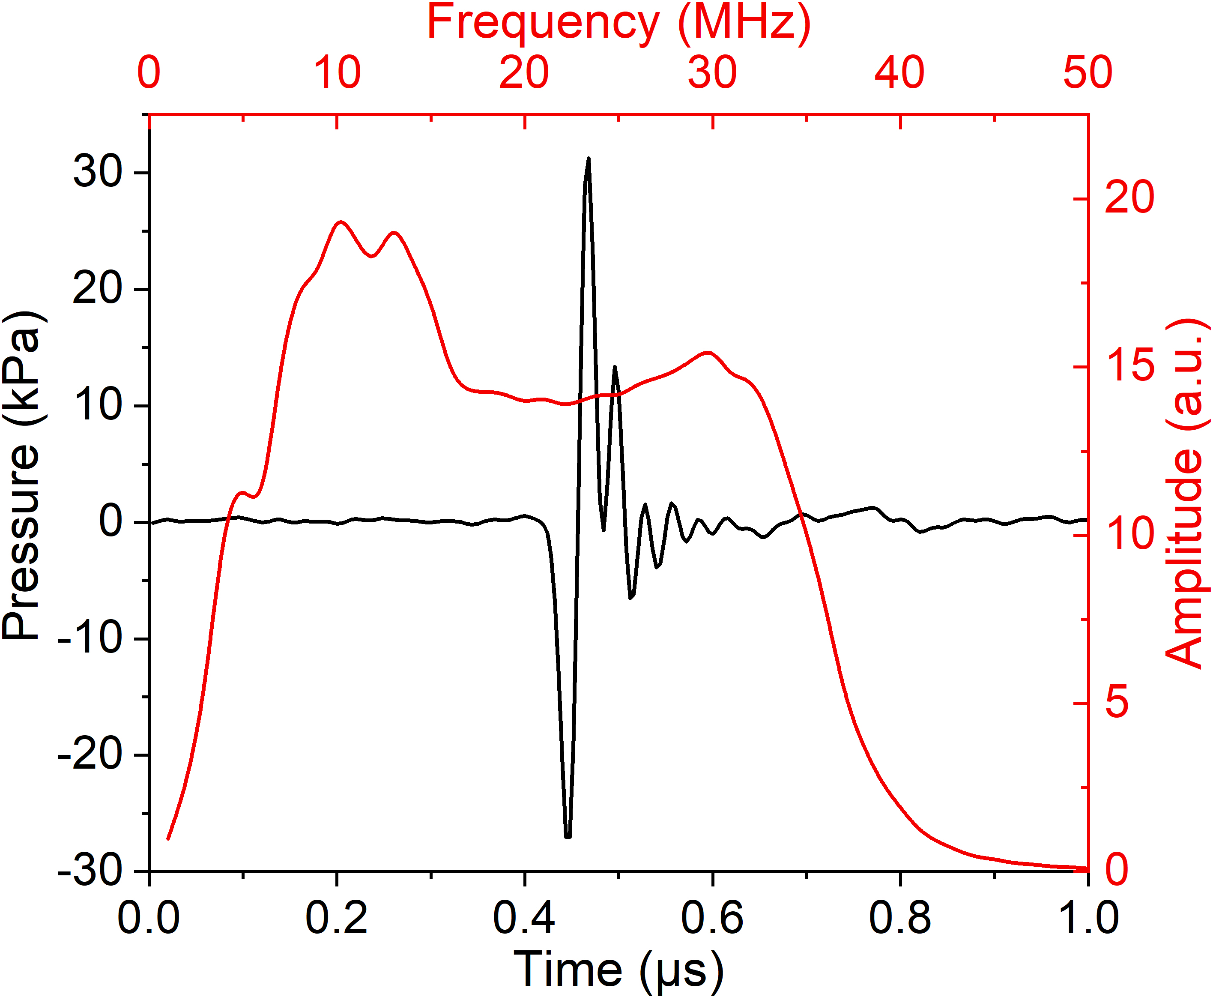
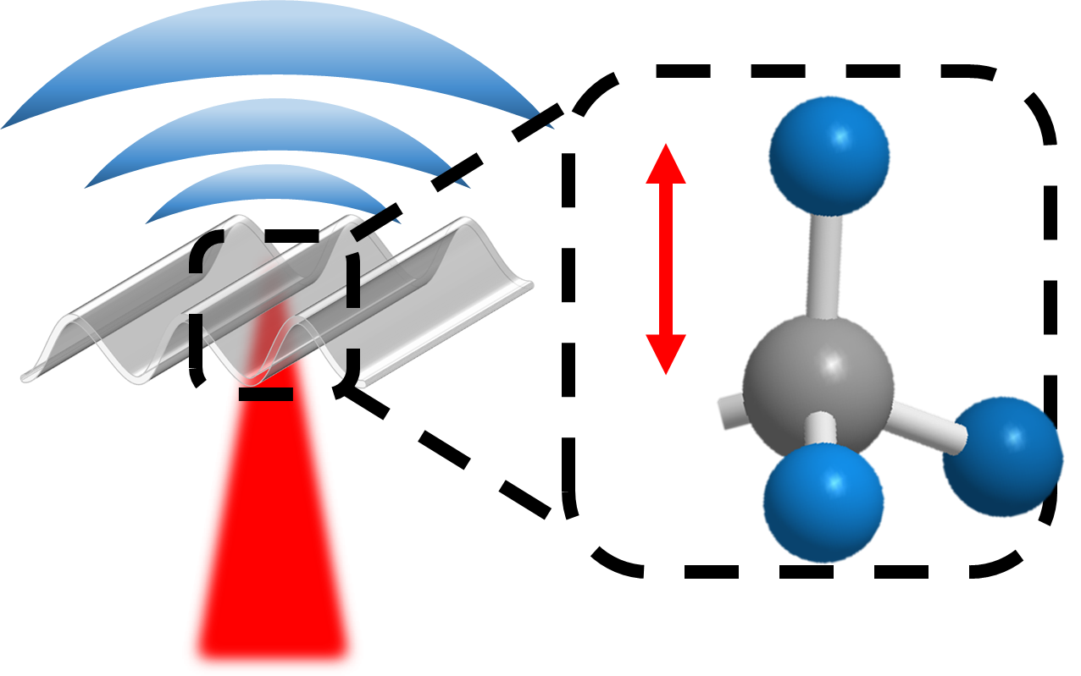
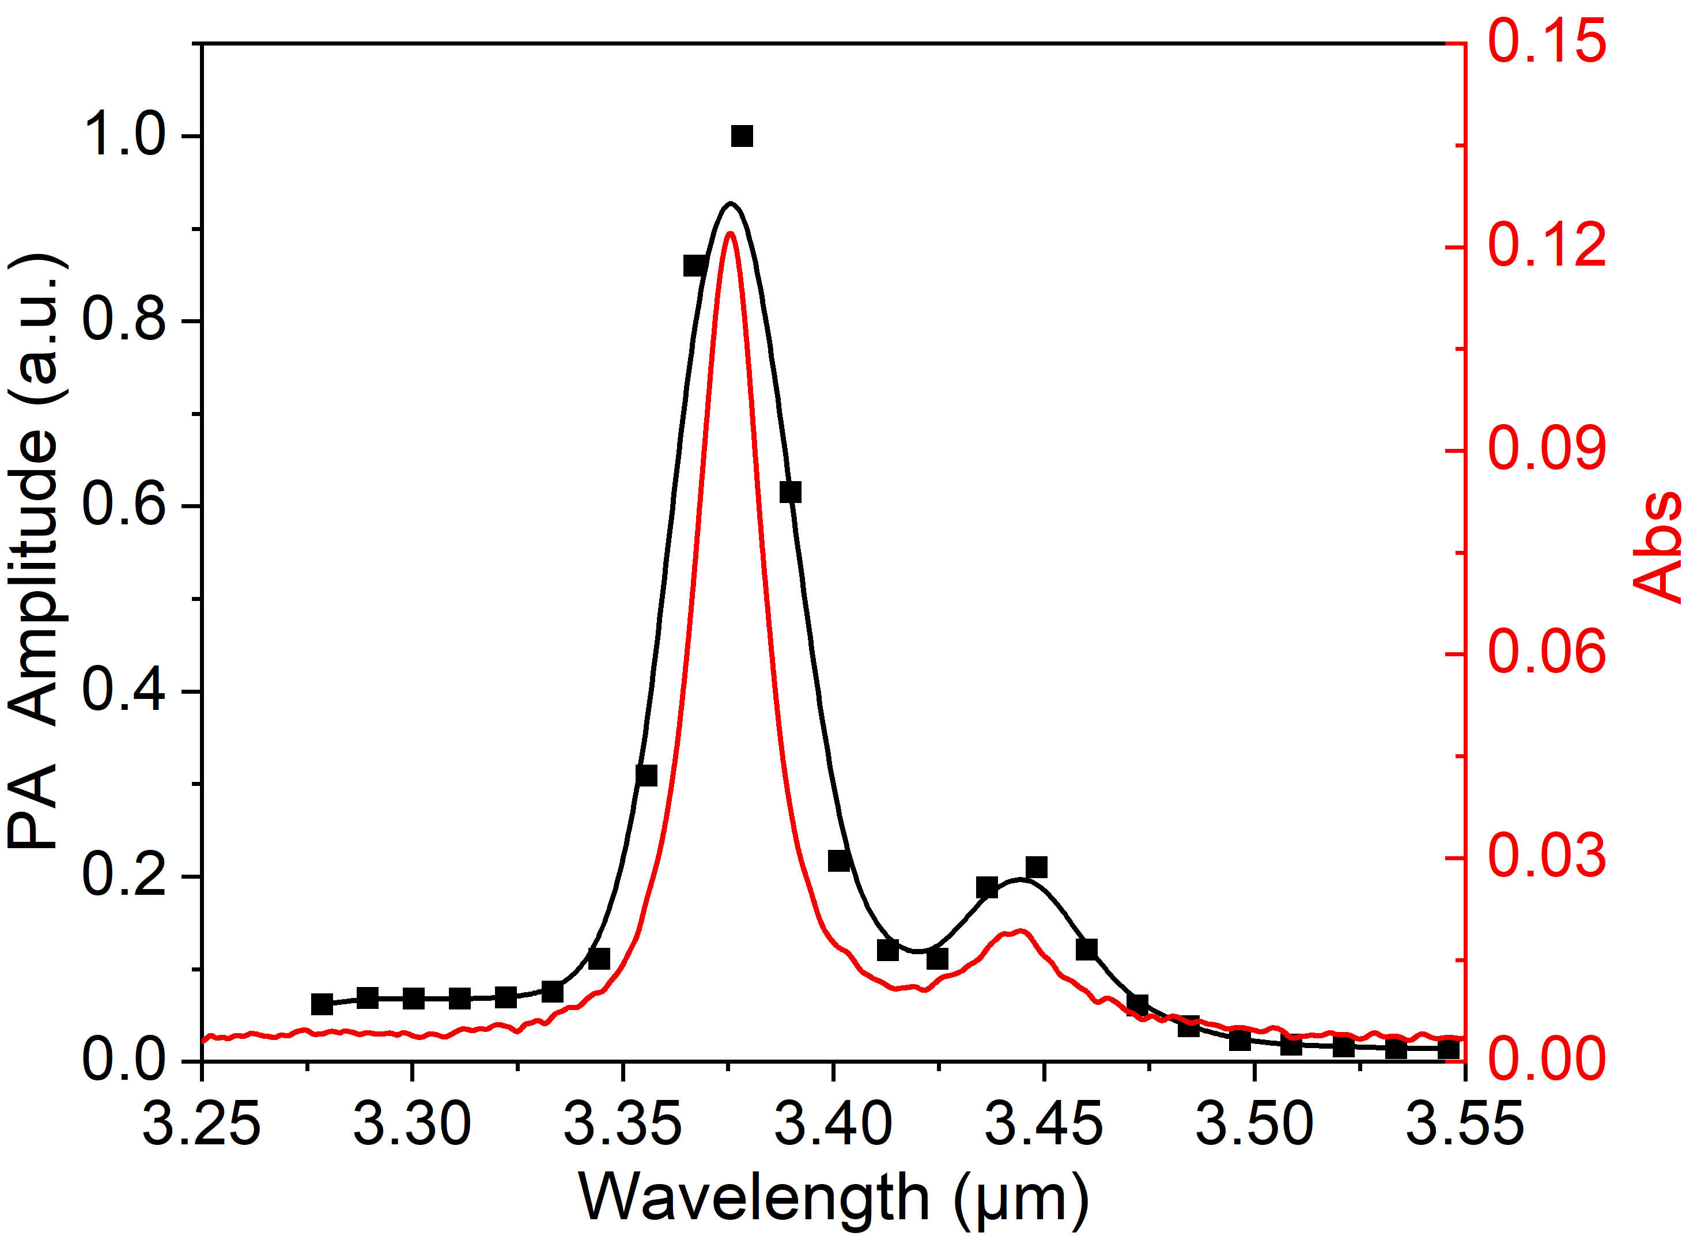
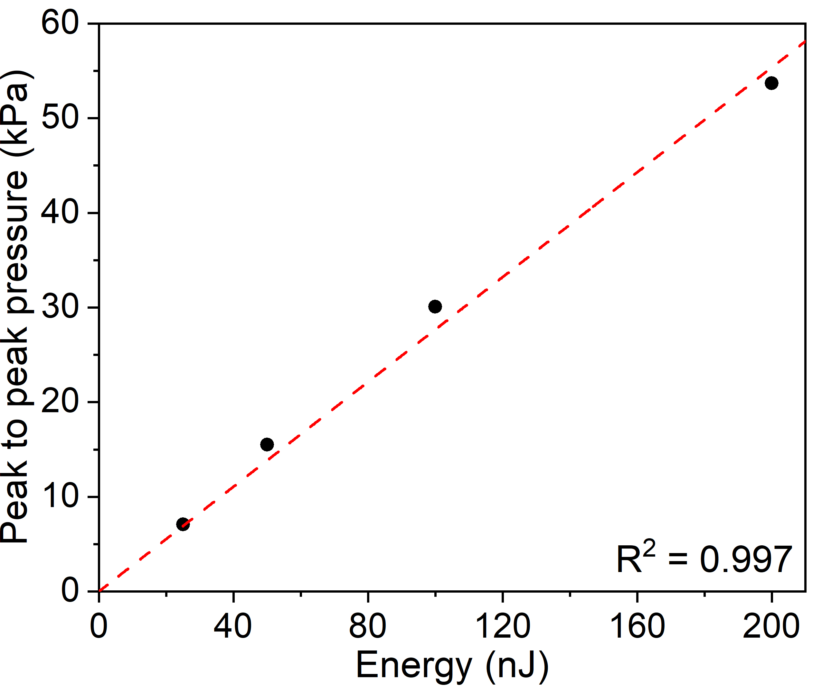
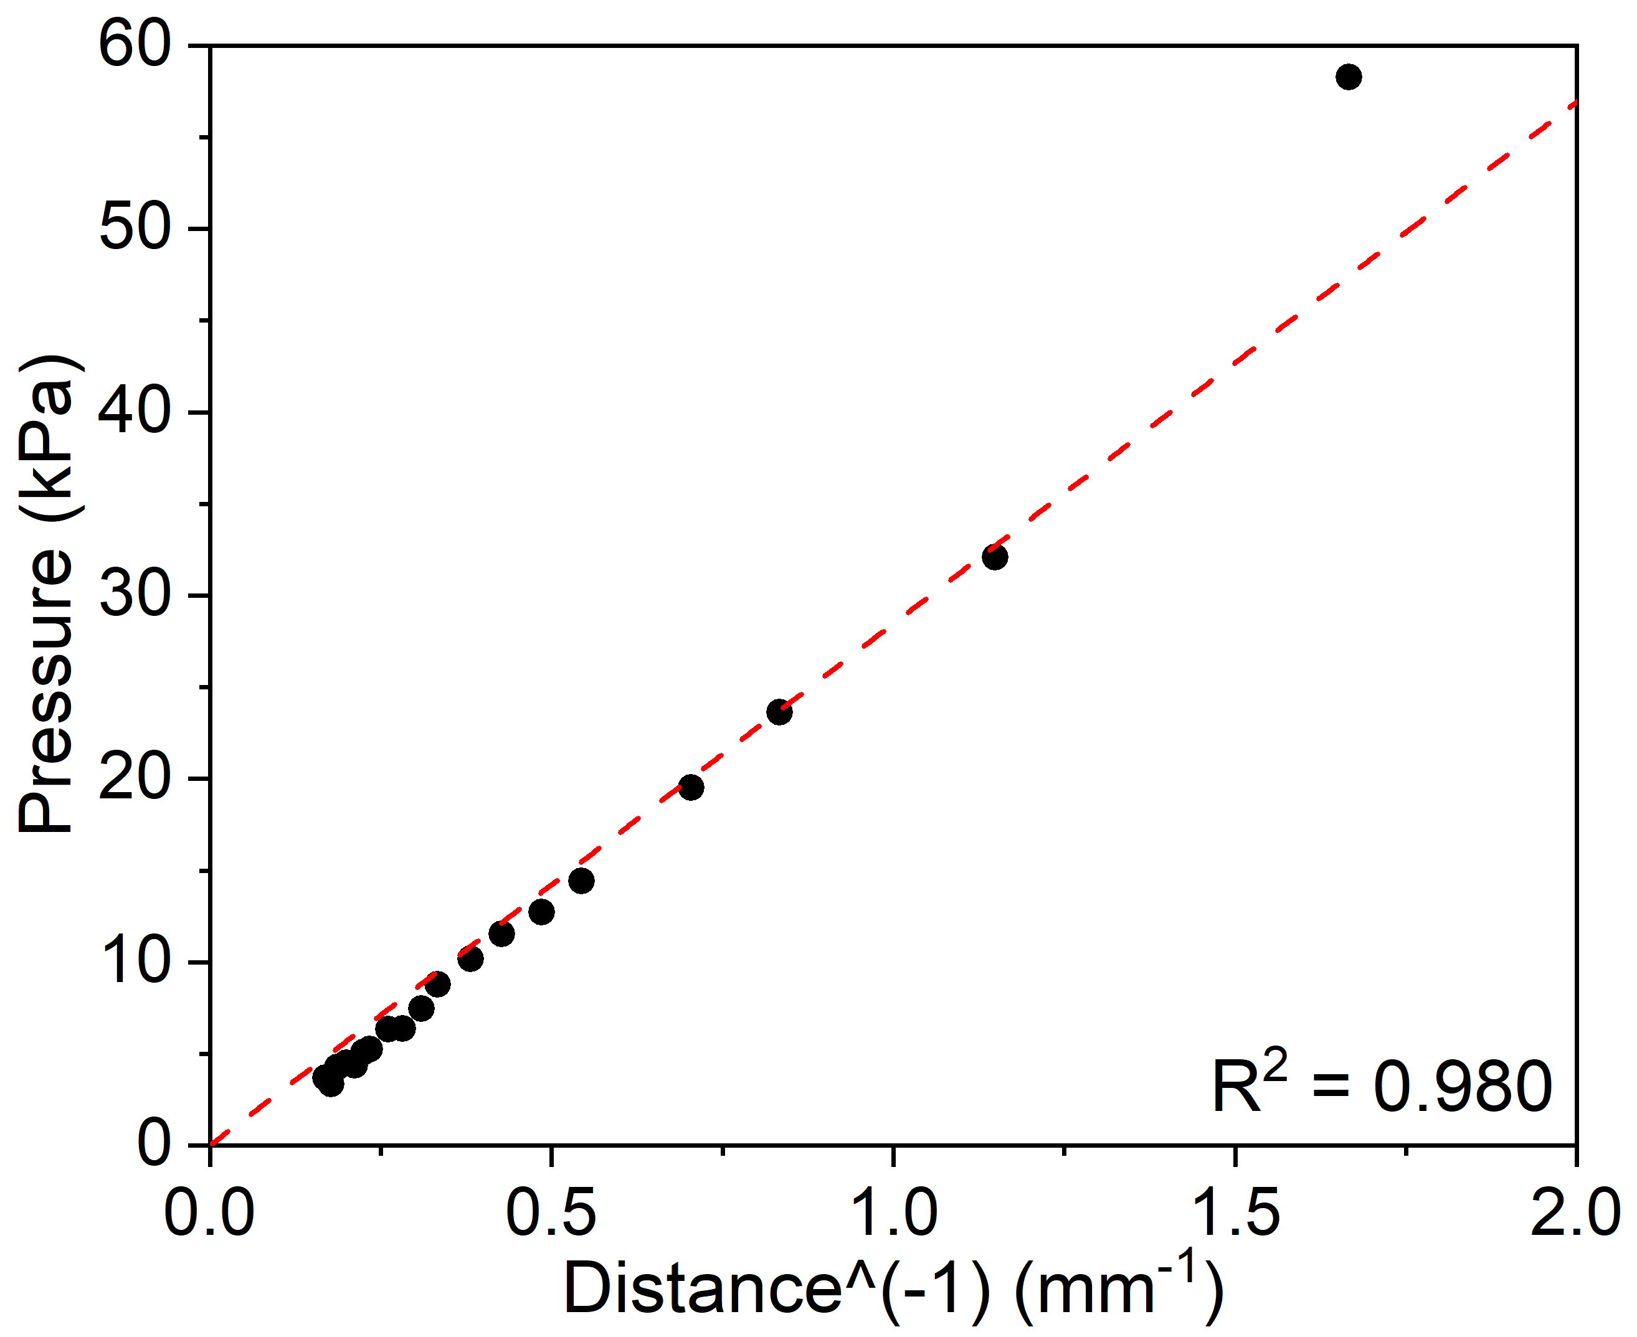
Figure 1: PDMS: Bond-selective photoacoustic emitter
A
B
C
D
E
F
Figure 1. PDMS: Bond selective photoacoustic emitter. A. Schematic of C-H bond vibration triggered PA film. B. FTIR spectrum of PDMS. C. Photoacoustic waveform in time domain and frequency domain. (Laser: 3.38 μm wavelength,10 ns pulse width, 0.2 μJ pulse energy.) D. Photoacoustic spectrum of 15-μm thick PDMS film in mid-infrared region. E. Laser energy dependence of MIPA amplitude. F. Peak to peak photoacoustic amplitude measured with different distance from the PA source and hydrophone. Black dot: experimental data. Red dashed line: fitted curve.
1A FTIR spectrum of PDMS film with the thickness of 1 um from
1C absorption spectrum of 5 mm CaF2 from Thorlabs
Laser: M Squared
Energy: 0.2 uJ
Repetition rate: 150 kHz
Pulse duration: 10 ns
Thickness: 23.2 um
PA measurement: needle hydrophone (40 um diameter)

